Slide 1

Watermanagement 4.0
Examples of „digital“ cooperations between Utility//SME//start-up

Slide 2
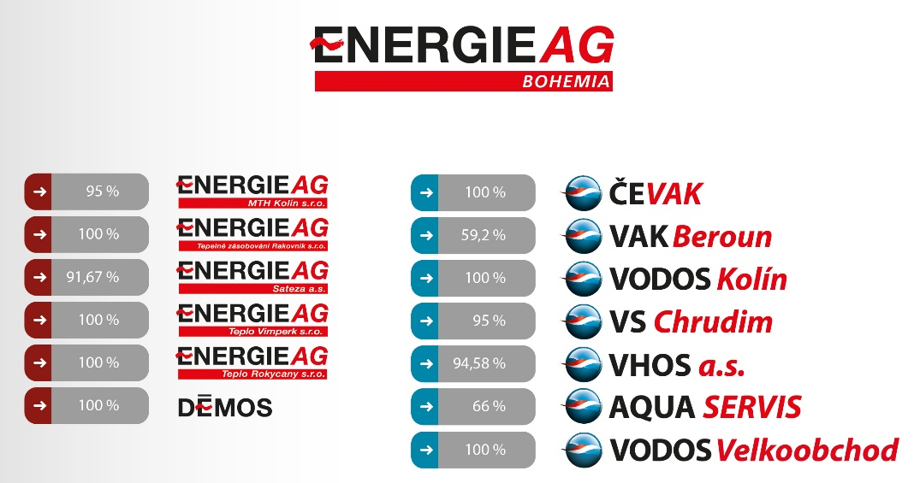
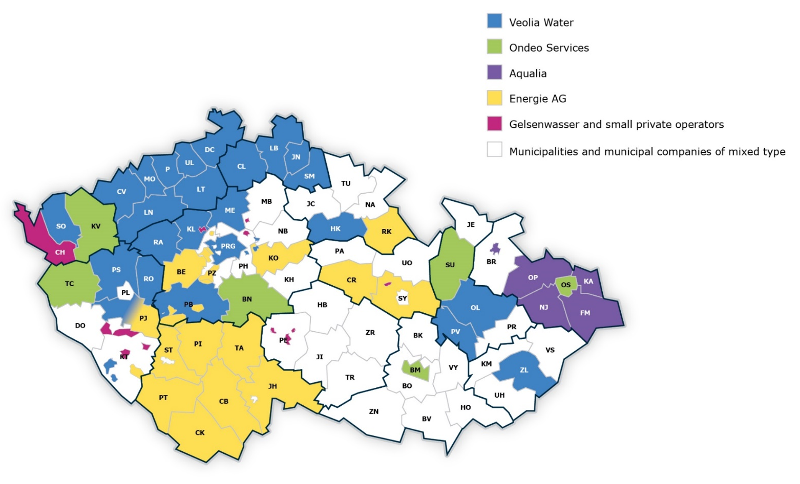
EnergieAG in Czech Watersector

Slide 3
Examples and experiences
Ex.01 Us…
a worldwide high tech firm and an Austrian leak specialist
Ex.02 Us…
and a one man start-up
Ex.03 Us…
a slowenien IT specialist and a Czech
electronics SME

Slide 4
Ex.01: Satellite Leak Detection and Field survey - UTIILS/IS and KSC/AT

Slide 5
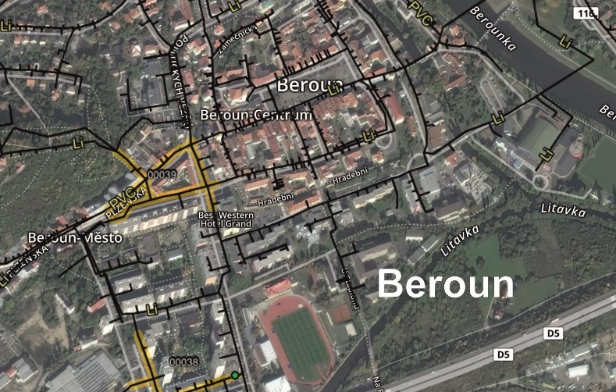
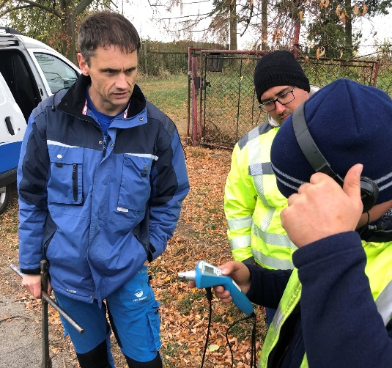


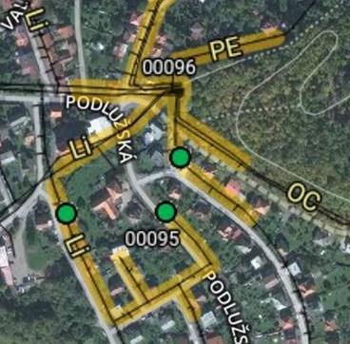
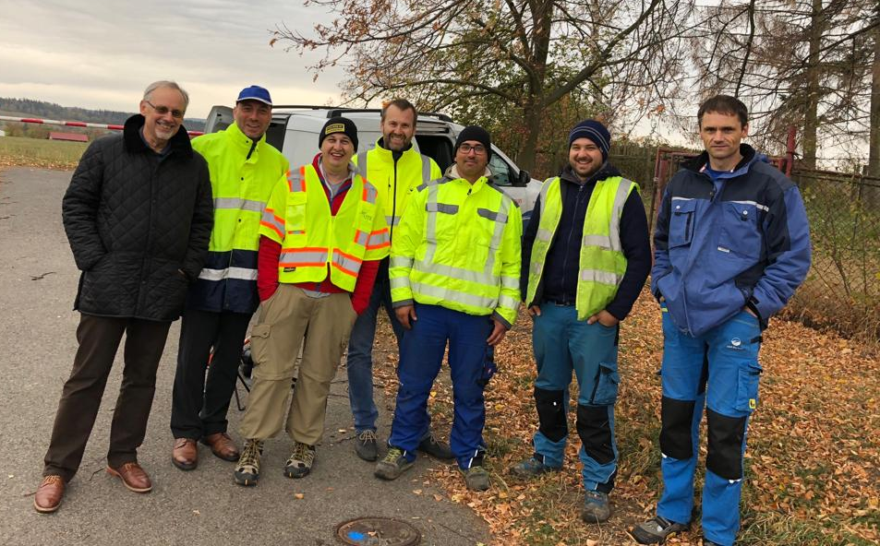
Satellite Leak Detection

Slide 6
Winking lessons learned
Compared to IT firms we are quite slow
We have excellent leak experts (and equipment), but don‘t give them the time to be most effective
Our experts
are quite sceptical for new solutions and approaches
are very enthusiastic when it works to their surprise
are ready to change operational procedures and organisational structures if proofed necessary
In discussion/preparation
Setting up new/additional regional leak detection teams
Regularly satellite leak detection survey

Slide 7


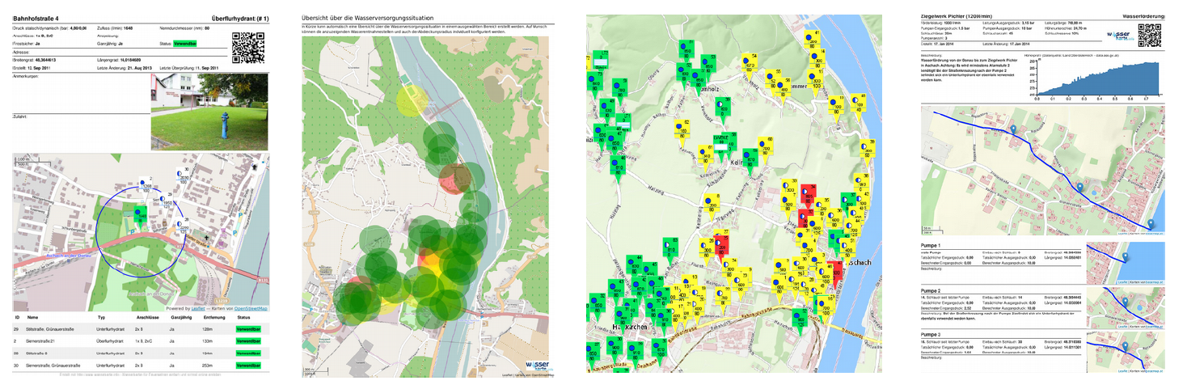
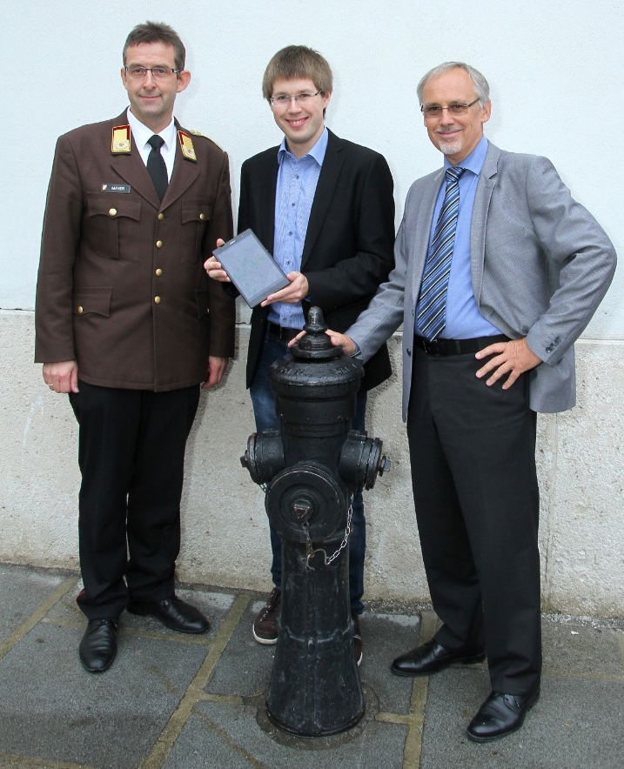
Ex.02: Start-up cooperation

Slide 8
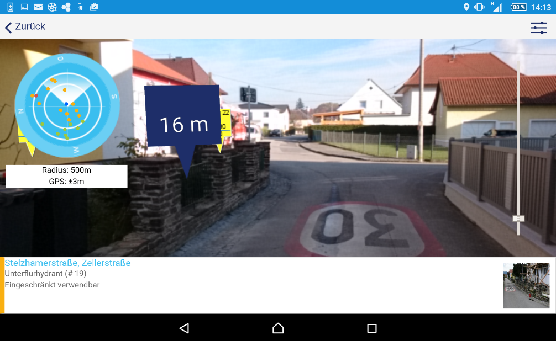
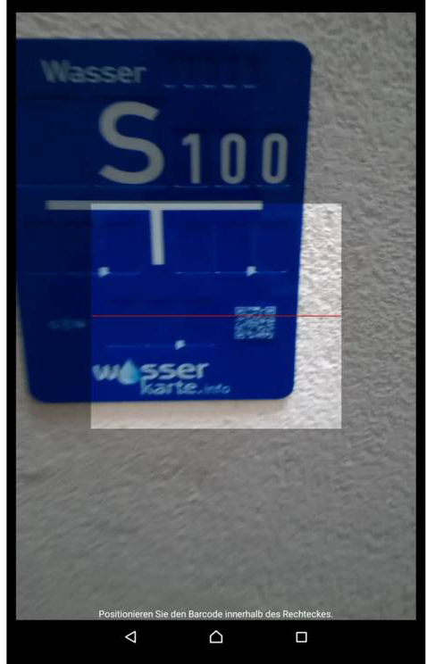

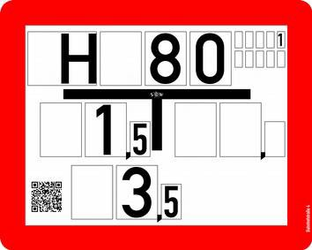
Augmented reality und smart grid

Slide 9
Winking lessons learned
Compared to start-up‘s we are not quite, we are very slow
Our experts
are quite sceptical for new solutions and approaches
Convincing them takes time, but
if convinced the comittment is 100%
In progress
after CIS, EIS, GIS…
we are introducing TIS and mobile operation slowly but surely
it‘s also a matter of CAPEX but
limiting factor are HR resources

Slide 10
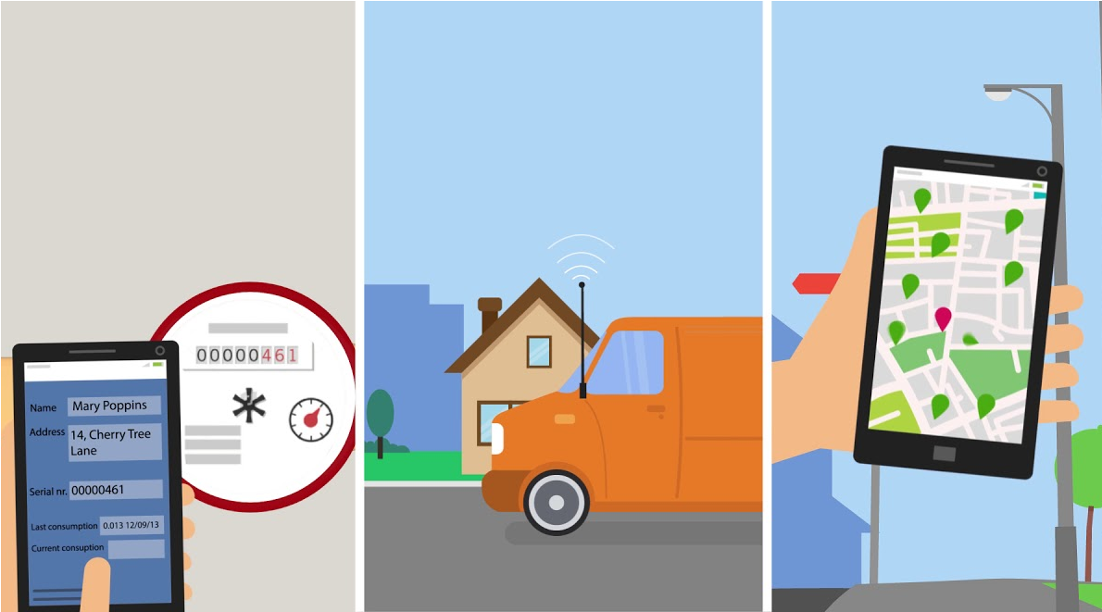
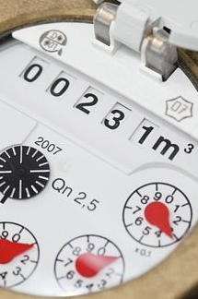


Ex.03: Smart Meter, eMr and new customer services
Utility Requirements Customer
User friendly for the staff
Integration with CRM and GIS
Analytical tool for network operation
eMR – easy Meter Reading
Consumption information
Alarms – unexpected situations
Customization
VpK – Voda pod kontrolou

Slide 11


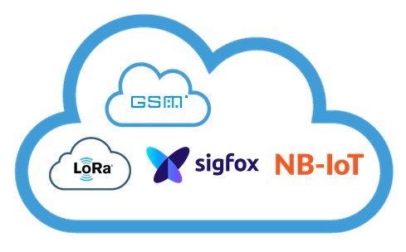
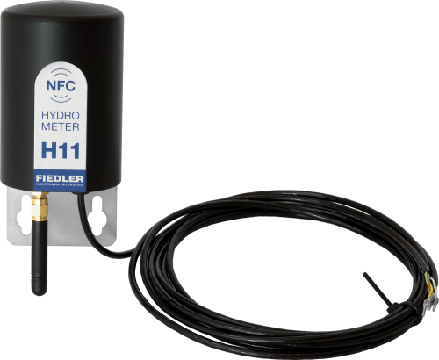
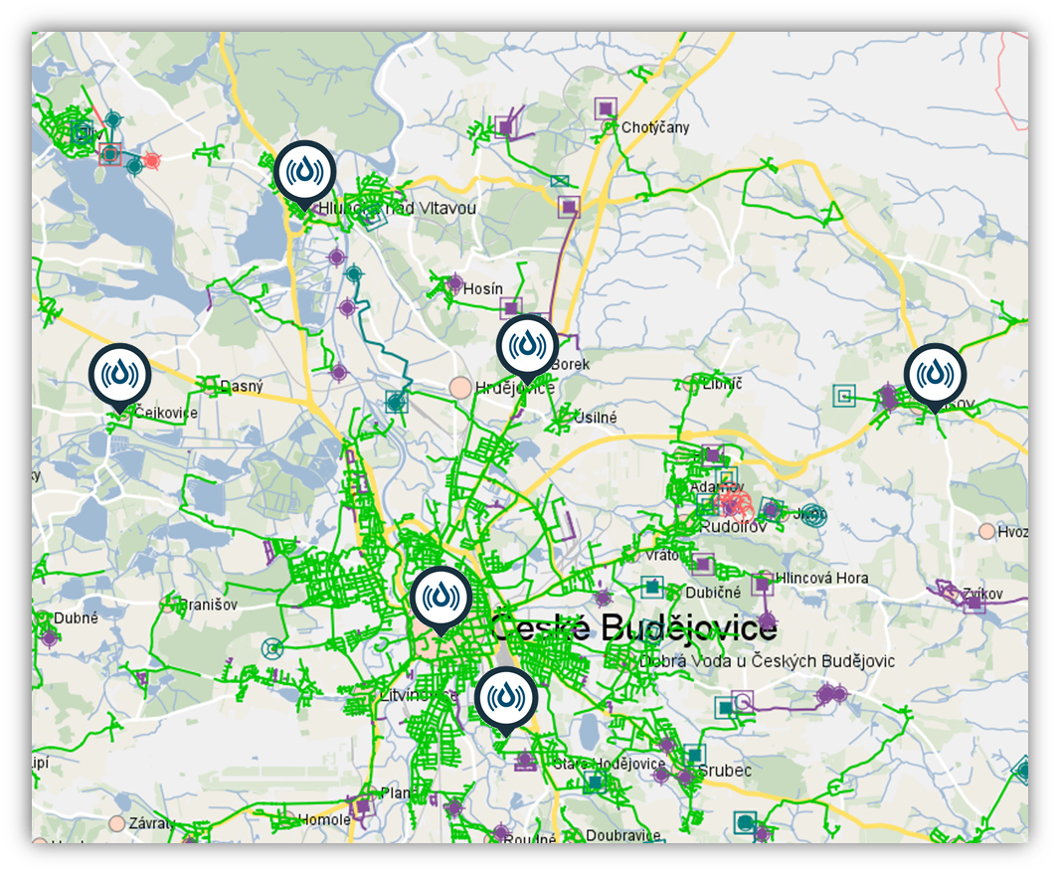
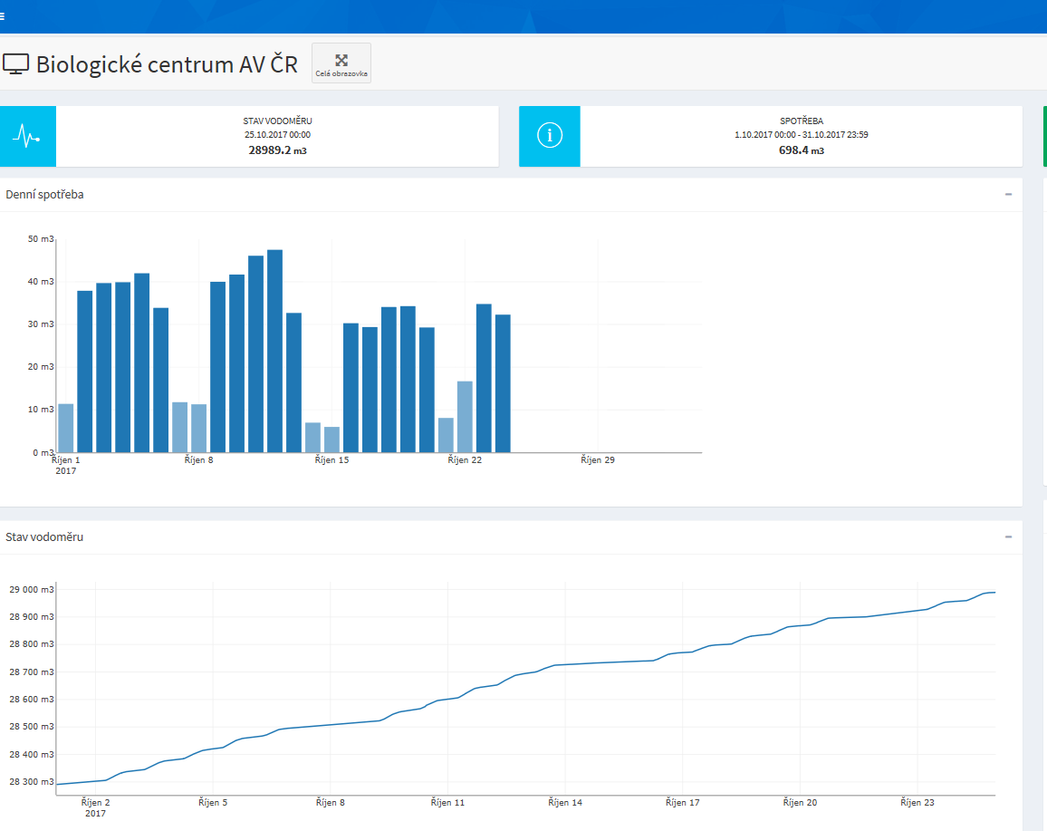





Ex.03
Infotim Ržišnik Perc d.o.o.

Slide 12
Winking lessons learned
clear common vision and target
The tempo of the project partners developments was fast and comparable to each other, because
(hypotheses) water engineers are not deeply involved?
Our experts
are looking for the 100% perfect solution, before going on the market
Testing and testing and testing – no beta versions
loosing time – but gaining security
Next steps/tests
IOT
smart network operation

Slide 13

Summary
Watermanagement 4.0 is a fact
we face CAPEX and HR challenges
The usual speed of the water sector is way too slow
Cooperations with Partners from related branches or from
outside the sector are fruitful
Let‘s stay open, even enthusiastic but never uncritical
and let‘s not forget countries
without watermanagement 1.0

